Slide 1
Chapter 8
Earthquakes

Slide 2
Earthquakes
Earthquakes result from sudden motions along breaks in Earth’s crust and can affect landforms and societies.
An entire branch of Earth science, called seismology, is devoted to studying earthquakes.
Earthquakes are complex, and they present many questions for seismologists, the scientists who study earthquakes.

Slide 3
Where Do Earthquakes Occur?
Most earthquakes take place near the edges of tectonic plates.
Tectonic plates are giant pieces of Earth’s thin, outermost layer. Tectonic plates move around on top of a layer of plastic rock.

Slide 4
Tectonic Plates
Tectonic plates move in different directions and at different speeds. Two plates can push toward or pull away from each other. They can also slip slowly past each other.
As a result of these movements, numerous features called faults exist in the Earth’s crust.

Slide 5
Tectonic Plates / Faults
A fault is a break in the Earth’s crust along which blocks of the crust slide relative to one another. Earthquakes occur along faults because of this sliding.

Slide 6
Deformation
As tectonic plates push, pull, or slip past each other, stress increases along faults near the plates’ edges. In response to this stress, rock in the plates deforms.
Deformation is the change in the shape of rock in response to stress. Rock along a fault deforms in mainly two ways. It deforms in a plastic manner, like a piece of molded clay, or in an elastic manner, like a rubber band.

Slide 7
Elastic deformation leads to earthquakes. Rock can stretch farther without breaking than steel can, but rock will break at some point.
Think of elastically deformed rock as a stretched rubber band. You can stretch a rubber band only so far before it breaks.

Slide 8
Elastic Rebound
The sudden return of elastically deformed rock to its original shape is called elastic rebound. Elastic rebound is like the return of the broken rubber-band pieces to their unstretched shape.
Elastic rebound occurs when more stress is applied to rock than the rock can withstand.
During elastic rebound, energy is released. Some of this energy travels as seismic waves.

Slide 9
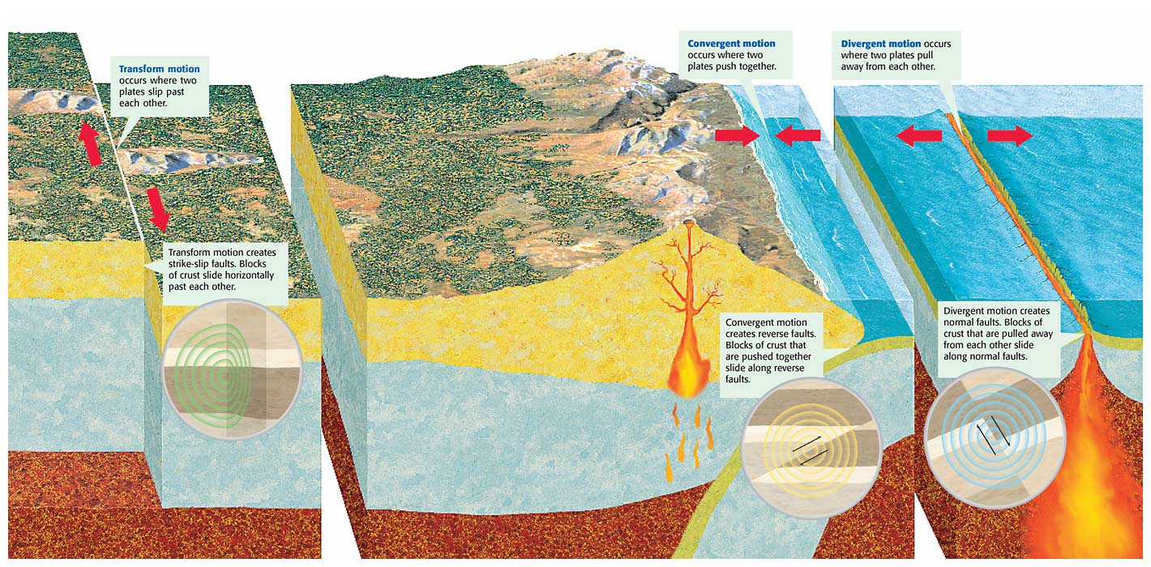
Faults at Tectonic Plate Boundaries

Slide 10
Earthquake Zones
Most earthquakes happen in the earthquake zones along tectonic plate boundaries.
Earthquake zones are places where a large number of faults are located.
The San Andreas Fault Zone in California is an example of an earthquake zone.

Slide 11
How Do Earthquake Waves Travel?
Waves of energy that travel through the Earth are called seismic waves.
Seismic waves that travel through the Earth’s interior are called body waves.
  There are two types of body waves: P waves and S waves.
Seismic waves that travel along the Earth’s surface are called surface waves.

Slide 12
Seismic Waves
Each type of seismic wave travels through Earth’s layers in a different way and at a different speed. Also, the speed of a seismic wave depends on the kind of material the wave travels through.

Slide 13
P Waves
Waves that travel through solids, liquids, and gases are called P waves (pressure waves).
They are the fastest seismic waves, so P waves always travel ahead of other seismic waves.
P waves are also called primary waves, because they are always the first waves of an earthquake to be detected.

Slide 14
S Waves
Rock can also be deformed from side to side. After being deformed from side to side, the rock springs back to its original position and S waves are created.
S waves, or shear waves, are the second-fastest seismic waves

Slide 15
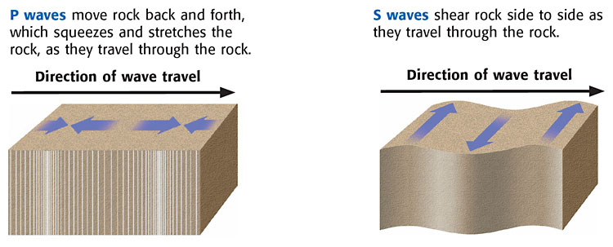
P Waves and S Waves

Slide 16
Surface Waves
Surface waves move along the Earth’s surface and produce motion mostly in the upper few kilometers of Earth’s crust.
There are two types of surface waves. One type of surface wave produces motion up, down, and around

Slide 17
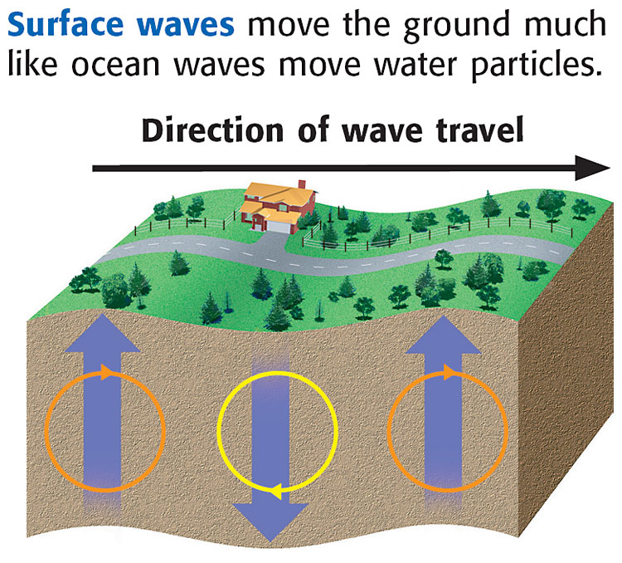
Surface Waves

